Slide 1
A Lightweight Defense Framework
for AI-Driven Scams
Project ID – R26 – CS-011

Slide 2

A Lightweight Defense Framework for AI-Driven Scams
Introduction
AI technologies increasingly used by cybercriminals to generate highly convincing scam & phishing messages.
SL-CERT has reported a significant rise in phishing and online scam incidents in Sri Lanka.
Scams lead to financial losses, identity theft, data breaches, and reduced trust in digital platforms.
Existing solutions focus on network/malware attacks — not AI-driven social engineering.
Users: Individuals & SMBs
Stakeholders: Platform providers, cybersecurity orgs, regulatory authorities
Project ID - R26 – CS - 011

Slide 3
A Lightweight Defense Framework for AI-Driven Scams
Existing Solutions & Their Limitations
Current Security Tools
Limitations
Focus mainly on network-level or system-level attacks
1. Firewalls
2. Intrusion Detection Systems (IDS)
Limited ability to detect AI-generated scam content and social engineering tactics
3. Intrusion Prevention Systems (IPS)
Expensive & complex for individuals and SMBs
4. Endpoint Detection & Response (EDR)
5. Spam Filtering Systems
Lack of integrated, lightweight protection for scam detection & user awareness
Project ID - R26 – CS - 011

Slide 4
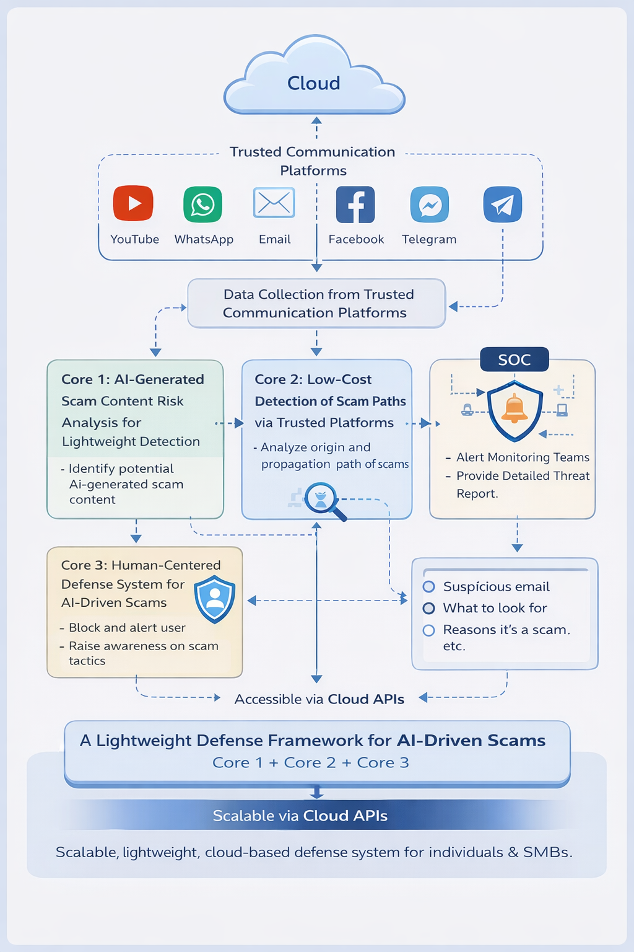

A Lightweight Defense Framework for AI-Driven Scams
Overview of System
Project ID - R26 – CS - 011

Slide 5
How Our Framework Overcomes the Limitations
A Lightweight Defense Framework for AI-Driven Scams
Network/system-level focus only
Analyzes message content & behavioral patterns to detect social engineering scams.
Cannot detect AI-generated scam content
Uses AI-driven risk analysis to identify suspicious language in AI-generated messages.
Too expensive for SMBs & individuals
Lightweight, low-cost cloud-based solution accessible via simple APIs.
No integrated scam awareness tool
Combines scam detection, path analysis & human-centered awareness in one framework.
Project ID - R26 – CS - 011

Slide 6

AI-Generated Scam Content Risk Analysis
Aberathna H.M.M.K | IT22277268 |
BSc (Hons) in Information Technology – Cyber Security
IT22277268 | Manodya Kavindi | R26-CS-011

Slide 7

AI-Generated Scam Content Risk Analysis
Problem statement
AI-generated scam content (deepfakes, fake voice messages, fraudulent ads) tricks users into sharing sensitive information. Traditional tools focus on malware and cannot identify persuasive scam media on social platforms or messaging apps.
IT22277268 | Manodya Kavindi | R26-CS-011

Slide 8
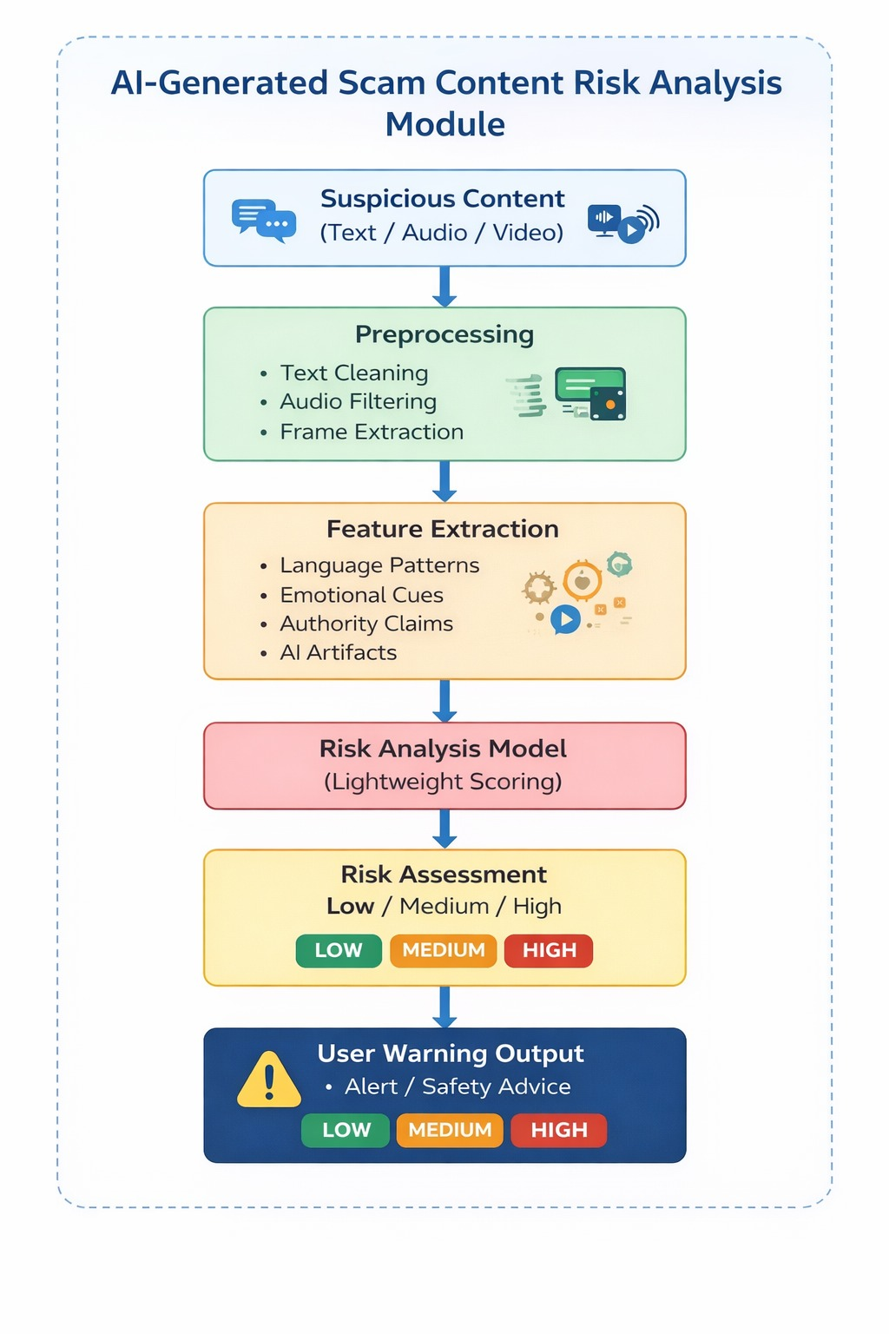

AI-Generated Scam Content Risk Analysis
System Diagram
IT22277268 | Manodya Kavindi | R26-CS-011

Slide 9
AI-Generated Scam Content Risk Analysis
Novelties
Multi-modal Analysis
Lightweight Detection
Combines text, audio, video & linguistic cues for comprehensive scam detection
Optimized for low-resource environments & affordable deployment
Risk Scoring
NLP Pattern Analysis
Feature-based real-time risk assessment for early user warnings
Identifies deceptive language patterns in AI-generated content
IT22277268 | Manodya Kavindi | R26-CS-011

Slide 10
AI-Generated Scam Content Risk Analysis
Objectives and Technologies
Main Objective
Develop a lightweight method for analyzing AI-generated content and assessing its potential risk as scam material, enabling early warnings for individuals and SMBs.
Sub-Objectives
Identify distinguishing characteristics of AI-generated scam content across text, audio, and video formats
Design a lightweight risk assessment approach for low-resource environments
Explore multi-modal analysis techniques combining different content types
Technologies & Approach
Deepfake detection
NLP scam models
Multi-modal ML
Lightweight scoring
Data and Ethics
Public scam datasets
No Personal data collect
Use cybersecurity best practices
IT22277268 | Manodya Kavindi | R26-CS-011

Slide 11
AI-Generated Scam Content Risk Analysis
Dependencies, Common Components, and Validation
Dependencies and Common Components
Input acquisition mechanisms
Preprocessing modules
Risk scoring framework
User notification interface
Validation and Evaluation
Comparison between known AI-generated scam content and legitimate content
Testing detection accuracy using labelled datasets
IT22277268 | Manodya Kavindi | R26-CS-011

Slide 12

Explainable Platform Attribution for AI-Generated Scam Detection
PRIYADEWA P D J C | IT22628718|
BSc (Hons) in Information Technology – Cyber Security
IT22628718| Jayanindu Charitha| R26-CS-011

Slide 13
Explainable Platform Attribution for AI-Generated Scam Detection
Problem statement
Scammers use AI to create fake content and spread it through WhatsApp, Telegram, and Instagram. Current tools detect scams but CANNOT trace where they came from — making it impossible to stop them from spreading again.
IT22628718| Jayanindu Charitha| R26-CS-011

Slide 14
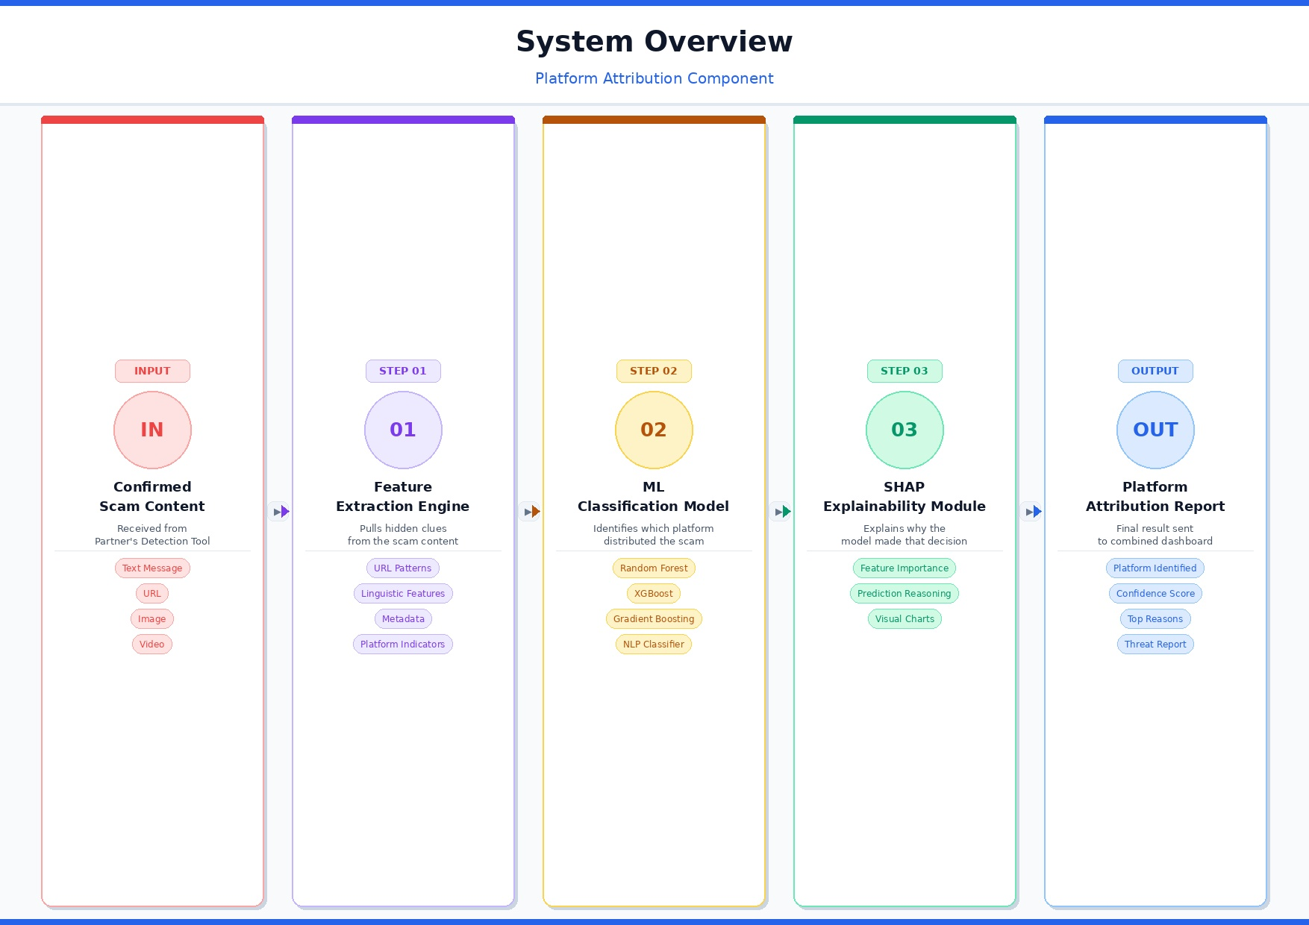
Explainable Platform Attribution for AI-Generated Scam Detection
System Diagram
IT22628718| Jayanindu Charitha| R26-CS-011

Slide 15
Explainable Platform Attribution for AI-Generated Scam Detection
Novelties
First lightweight platform attribution for AI scams
Multimodal fingerprinting
SHAP applied to platform attribution
Lightweight plug-in design
IT22628718| Jayanindu Charitha| R26-CS-011

Slide 16
Explainable Platform Attribution for AI-Generated Scam Detection
Objectives
Main Objective
Build a system that finds which platform spread the scam and clearly explains why
Sub-Objectives
Collect and prepare scam datasets
Extract hidden clues from scam content
Train ML model to identify the platform
Add SHAP to explain every decision clearly
Connect with partner's detection tool
Test and evaluate the full system
IT22628718| Jayanindu Charitha| R26-CS-011

Slide 17
Explainable Platform Attribution for AI-Generated Scam Detection
Technologies and Evaluation
Technologies Utilized
XGBoost
SHAP
BERT
ML Classification
Explainability
NLP Analysis
OpenCV
ExifTool
Flask
Image Processing
Metadata Extraction
API Backend
Evaluation Metrics: Accuracy · Precision · Recall · F1 · Attribution Rate (compared vs. existing tools + cross-validation)
IT22628718| Jayanindu Charitha| R26-CS-011

Slide 18

Human Centered Defense and Awareness System for AI – Driven Scams
VIDARA S V | IT22299048|
BSc (Hons) in Information Technology – Cyber Security
IT22299048| Visini Vidara| R26-CS-011

Slide 19
Human Centered Défense and Awareness System for AI – Driven Scams
Problem statement
AI-generated scams are increasing. Social engineering manipulation is growing. Current systems lack explanation - users still fall victim.
IT22299048| Visini Vidara| R26-CS-011

Slide 20
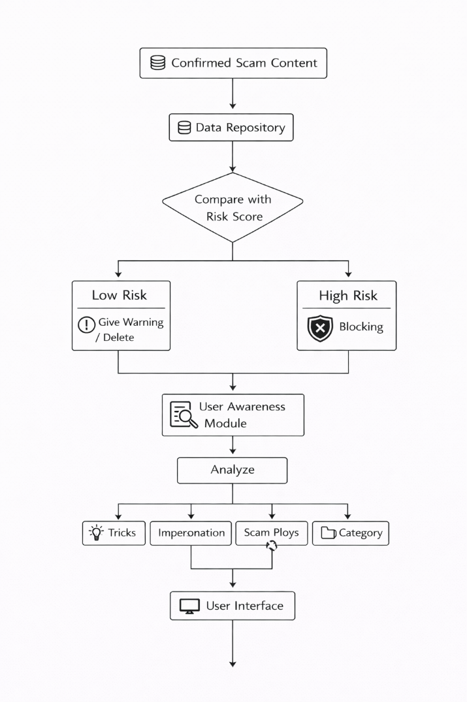
Explainable Platform Attribution for AI-Generated Scam Detection
System Diagram
IT22299048| Visini Vidara| R26-CS-011

Slide 21
Human Centered Défense and Awareness System for AI – Driven Scams
Novelties
Adaptive Blocking
Explainable Analysis
Soft → Hard blocking mechanism based on risk level
Identifies and highlights suspicious indicators in scam messages
Scam Breakdown
Awareness Dashboard
Visual breakdown of malicious message parts for user understanding
Helps users understand and recognize scam techniques over time
IT22299048| Visini Vidara| R26-CS-011

Slide 22
Human Centered Défense and Awareness System for AI – Driven Scams
Objectives and Knowledge Domain
Main Objective: Design a human-centered defense system for AI-driven scams
Sub-Objectives
• Adaptive blocking engine
• Scam explanation module
• Scam breakdown mechanism
• Awareness dashboard
Knowledge Domain
• Cybersecurity (Social Engineering Defense) – Understanding phishing and scam attack techniques.
• Artificial Intelligence & Natural Language Processing (NLP) - Detecting suspicious language patterns in scam messages.
• Human-Centered Security Design - Improving user awareness through explanation and visualization.
IT22299048| Visini Vidara| R26-CS-011

Slide 23
Human Centered Défense and Awareness System for AI – Driven Scams
Technology, Validation, Evaluation and Data Ethics
Technology Stack
Python
TensorFlow/PyTorch
spaCy/NLP
FastAPI/Flask
Core logic
AI models
Language analysis
Backend APIs
MongoDB/PostgreSQL
AWS/Google Cloud
React
Browser Extension
Data storage
Cloud infrastructure
Web dashboard
Scam blocking
Validation and Evaluation
• Blocking Decision accuracy
• False Positive Rate – legitimate messages flagged as scams
• User understanding score – evaluation using user survey or awareness score
Data and Ethics
• Public Datasets – Collecting data publicly available
• Data Anonymization – if using real message or simulated data, the system must protect user privacy
• Compliance with research ethics guidelines – following ethical standards for handling digital data.
IT22299048| Visini Vidara| R26-CS-011

Slide 24
Commercialization Strategy
A Lightweight Defense Framework for AI-Driven Scams
Target Market
Investment & Recovery
Individuals & SMBs concerned about AI-driven scams
Communication platform providers
Cybersecurity organizations & enterprises
Labour: Development, research & ML engineering team
Material: Cloud infrastructure (AWS/GCP), tooling
Recovery: SaaS subscription model + API licensing fees
Value Proposition
Intellectual Property
Lightweight, affordable protection vs. costly enterprise tools
Explainable AI decisions that build user trust
Integrated detection + awareness in a single platform
Novel multi-modal scam detection algorithm
Explainable attribution method (SHAP-based)
Human-centered adaptive blocking mechanism
Patent applications to be filed upon completion
Project ID - R26 – CS - 011

Slide 25
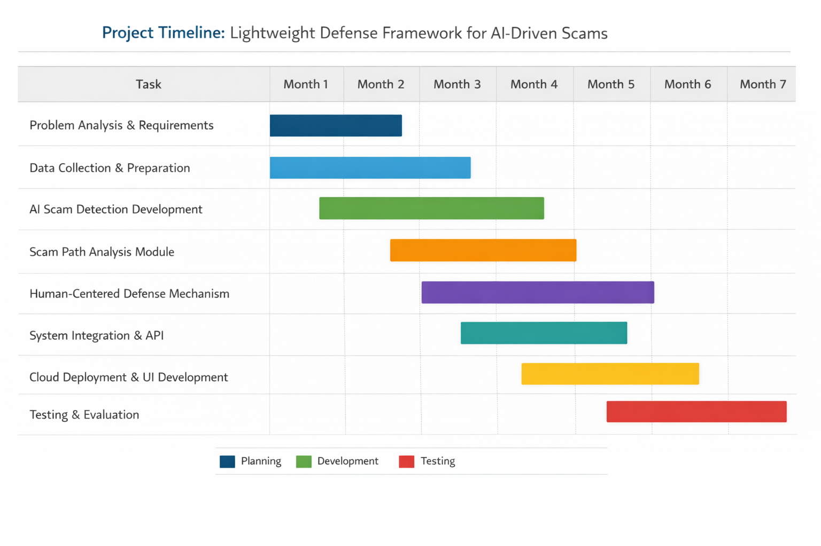
Project Plan & Work Breakdown Structure
A Lightweight Defense Framework for AI-Driven Scams
Project ID - R26 – CS - 011

Slide 26
A Lightweight Defense Framework for AI-Driven Scams
Conclusion
Unified Framework:
Three integrated components covering detection, attribution, and human-centered defense.
AI-Powered Protection:
Leverages NLP, multi-modal analysis, and explainable AI to fight AI-driven scams.
Accessible & Lightweight:
Designed for individuals and SMBs — affordable, cloud-based, easy to deploy.
Research-Backed:
Validated using public scam datasets with rigorous accuracy and ethics standards.
Project ID - R26 – CS - 011

Slide 27


Project ID - R26 – CS - 011

Slide 28


Project ID - R26 – CS - 011

